Slide 1
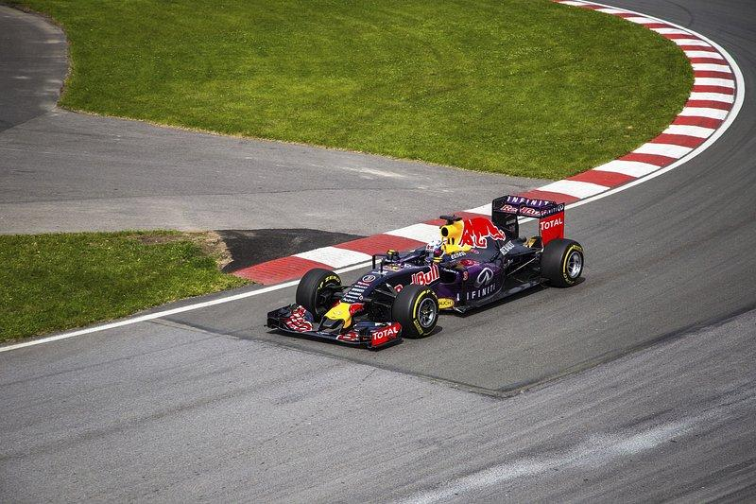
Formula 1
Data Analysis
Data 601 - Midterm presentation
by Sahith Reddy

Slide 2
About the Dataset
The dataset consists of all information on the Formula 1 races, drivers, constructors, qualifying, circuits, lap times, pit stops, championships from 1950 till the latest 2023 season.
Data from 1950 - 2023
14 CSV files
120 columns

Slide 3
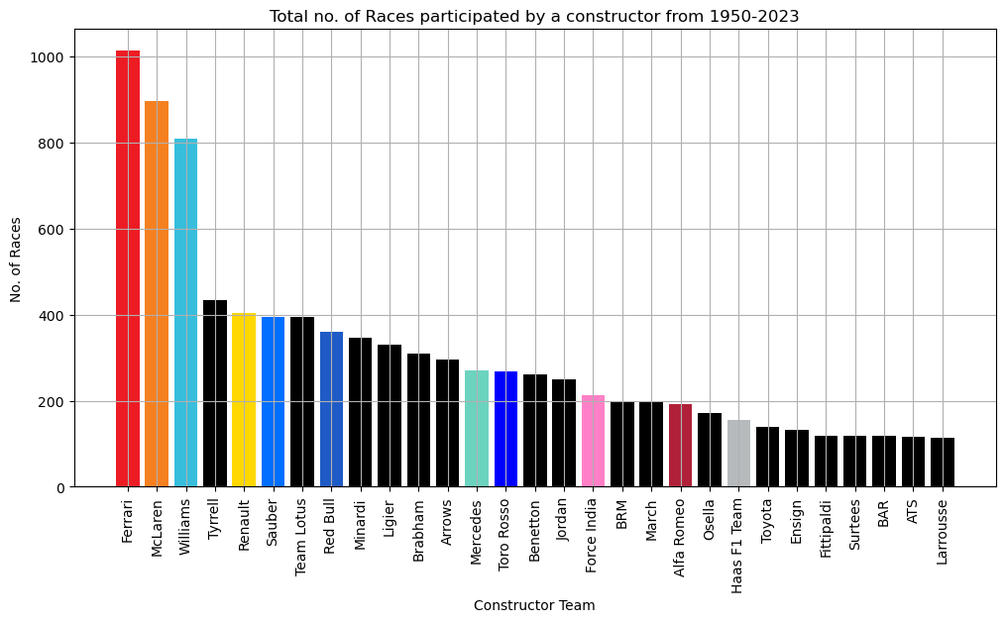
Total no. of Races participated by a constructor

Slide 4
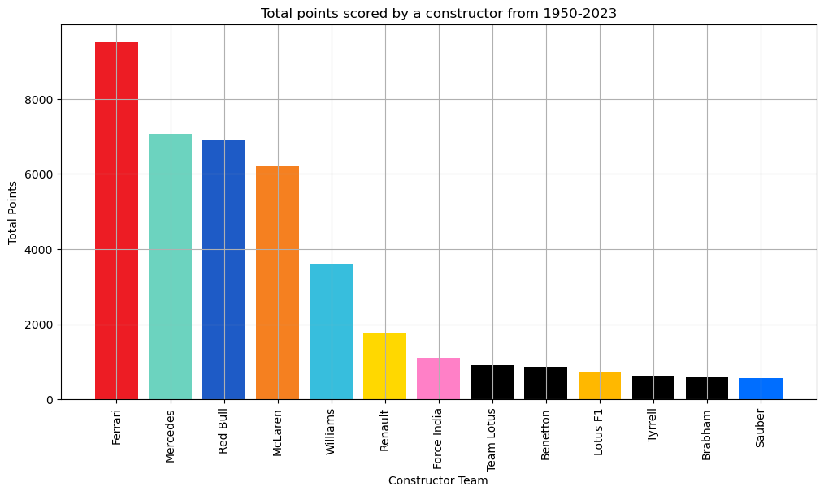
Total Points score by a constructor

Slide 5
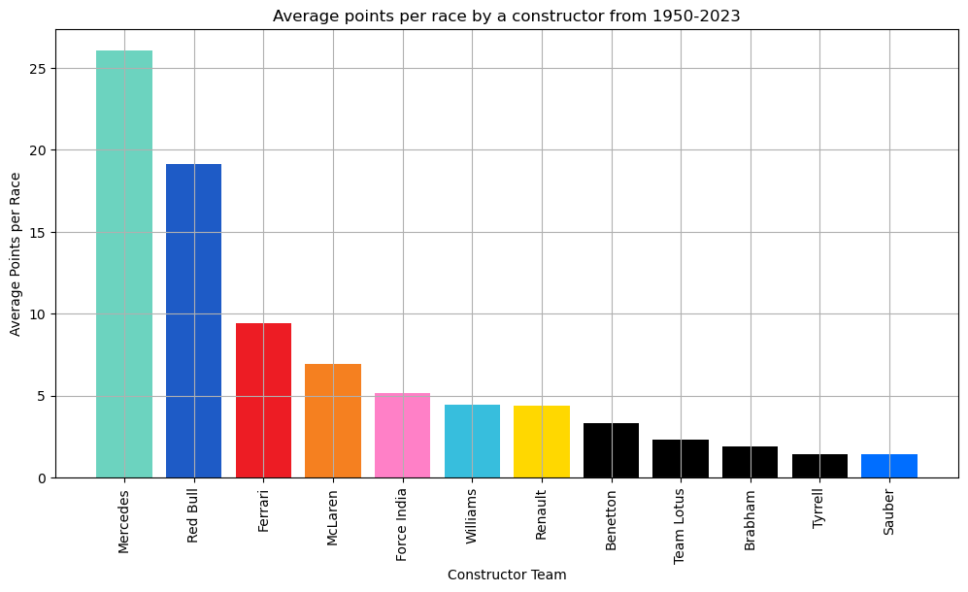
Average Points per Race by a constructor

